Slide 1
The characterization of gut microbial dysbiosis in animal models and human populations
Dr. Anthony Fodor
Associate Professor
Department of Bioinformatics
The University of North Carolina at Charlotte

Slide 2
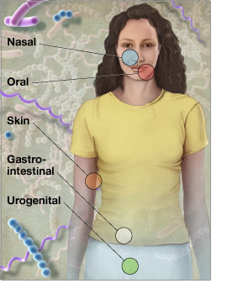
Microbes run the world!
There are as many microbial
cells in our body as human cells
There are more genes
in those microbes than human genes
http://www.genome.gov/images/feature_images/nr_hmp.jpg

Slide 3
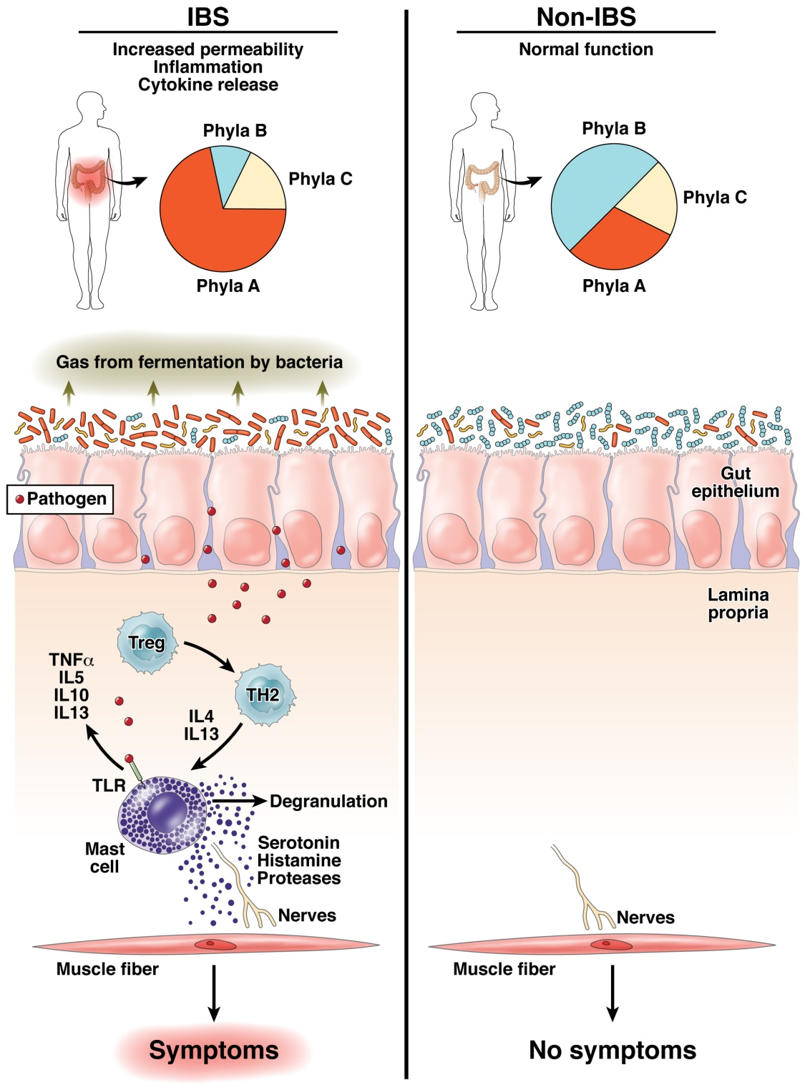
The “dysbiosis hypothesis” is central to our thinking about the role of the
microbiome in human health
Fodor & Talley. Gastroenterology. 2011

Slide 4
Case study: obesity

Slide 5
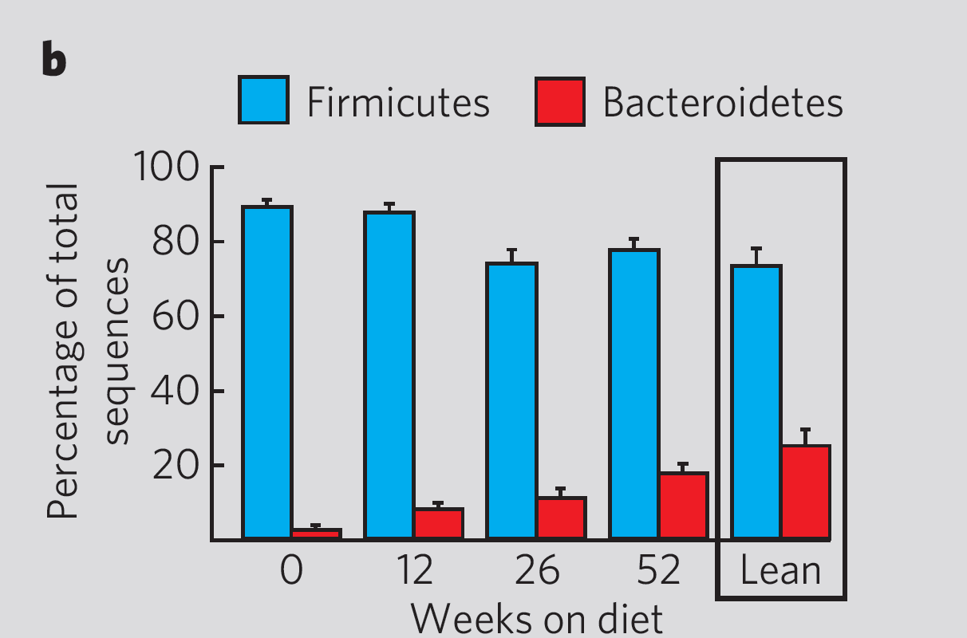
Initial results establishing a role for the microbiome in obesity were highly encouraging
2006
Ley et al - Human gut microbes associated with obesity – Nature, 2006

Slide 6
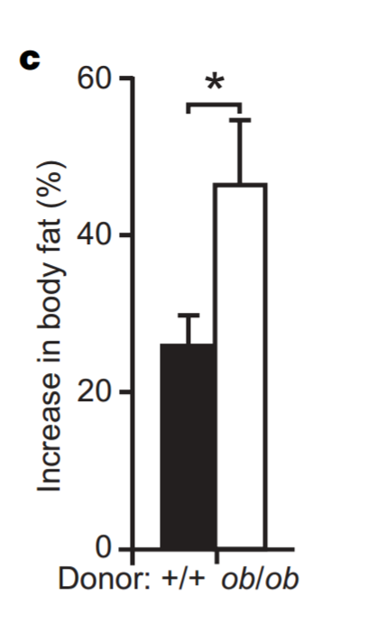
Obesity appeared to be a phenotype transferable through the microbiota
2006
Turnbaugh et al - An obesity-associated gut microbiome with increased capacity for energy harvest – Nature, 2006

Slide 7
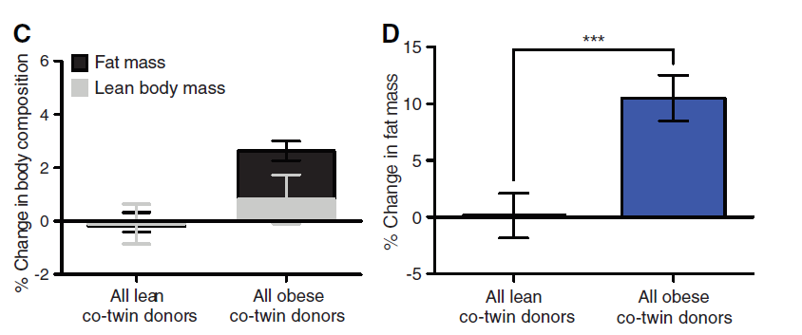
The transfer of obesity to mice via the microbiota appears replicable
2013
Ridaura et al - Gut Microbiota from Twins Discordant for Obesity Modulate Metabolism in Mice – Science, 2013

Slide 8
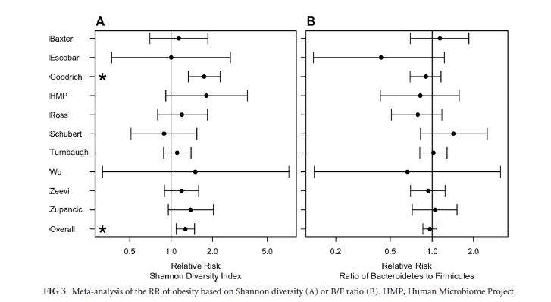
Associations in humans with the microbiota have proven much more difficult to replicate
2016
Sze and Schloss - Looking for a Signal in the Noise: Revisiting Obesity and the Microbiome– mbio, 2016

Slide 9
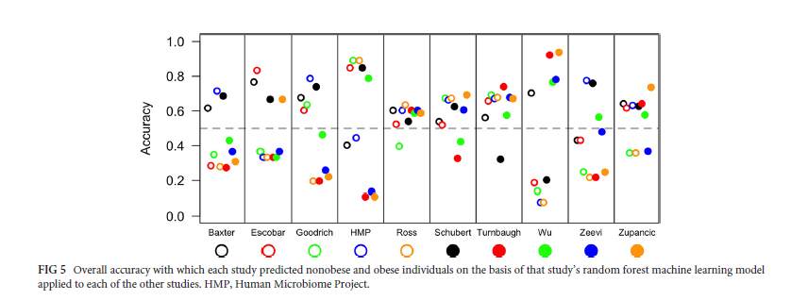
Replicability across studies appears especially poor
2016
Sze and Schloss - Looking for a Signal in the Noise: Revisiting Obesity and the Microbiome– mbio, 2016

Slide 10
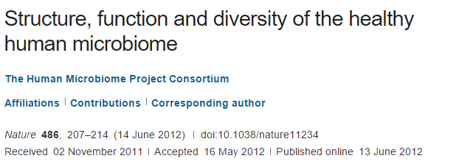
2012
We conclude that most variation in the human microbiome is not well explained by … phenotypic metadata

Slide 11
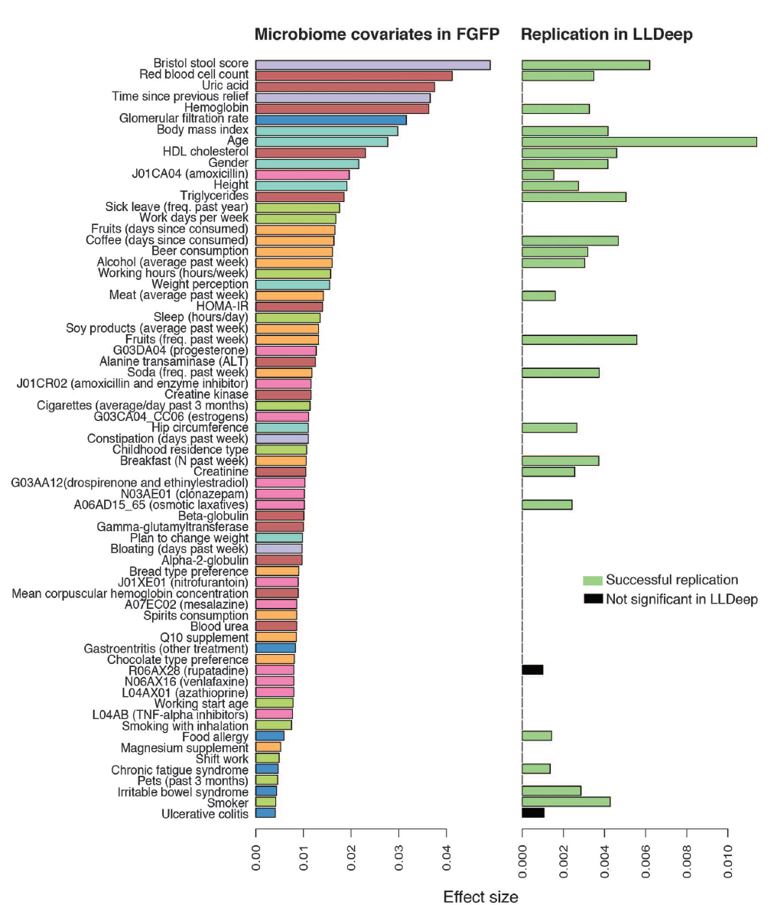
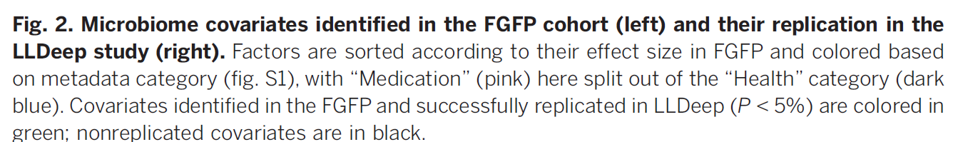
Microbial community composition and gene content is poorly associated with healthy variation
Initial analysis: 503 metadata variables
69 significant at 10% FDR
26 have analog in replication cohort
24 of these are significant
(but effect sizes in replicate cohort drop to << .01)
Power estimates suggests > 1600 subjects
needed to power BMI study…
2016
Falony et al. Population-level analysis of gut microbiome variation -Science 29 Apr 2016

Slide 12
The obesity hypothesis (2016)
The transfer of obesity to mice via the microbiota appears replicable
BMI, and apparently all other healthy human covariates,
have associations with the microbiota that are very small
Sample sizes in the thousands are appropriate for studies of healthy
human variation

Slide 13
What happens to the microbiome when you change diet?
B1
B2
D1
D2
R1
R2
V
V
V
V
V
V
Baseline 10d
Depletion up to 42d
Repletion 10d
2011
550 mg/ 60 kg
body weight
0 mg
850 mg/ 60 kg
body weight
In-patient
In-patient
In-patient
At each timepoint, a fecal sample was collected
and microbial DNA was isolated and characterized
Spencer et al, Association between composition of the human gastrointestinal microbiome and development of fatty liver with choline deficiency,2011

Slide 14
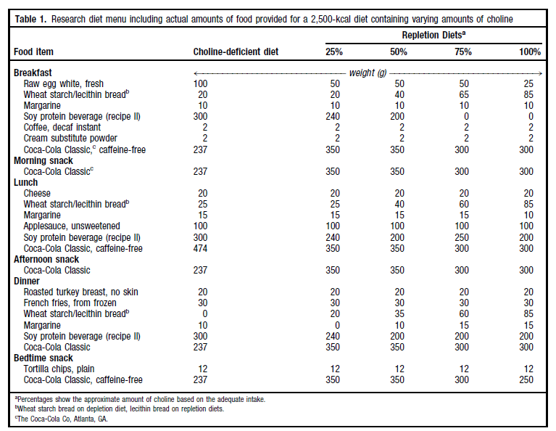
Subjects were exposed to a rigorously controlled diet…
2011

Slide 15
15 Patients
74 DNA samples isolated from fecal samples
Run on ½ of a 454-FLX LR70 plate using a “barcode” strategy
2011
213,375 16S rRNA sequences.
Average read length=264 bp.
( around $0.03 per sequence)
199,186 “usable” sequences
(Exactly match 5’-primer; length >200 bp)
Cluster into 7,514 Operational Taxonomic Units (OTUs)
in each of which all sequences are at least 97% identical
Spencer et al, Association between composition of the human gastrointestinal microbiome and development of fatty liver with choline deficiency,2011

Slide 16
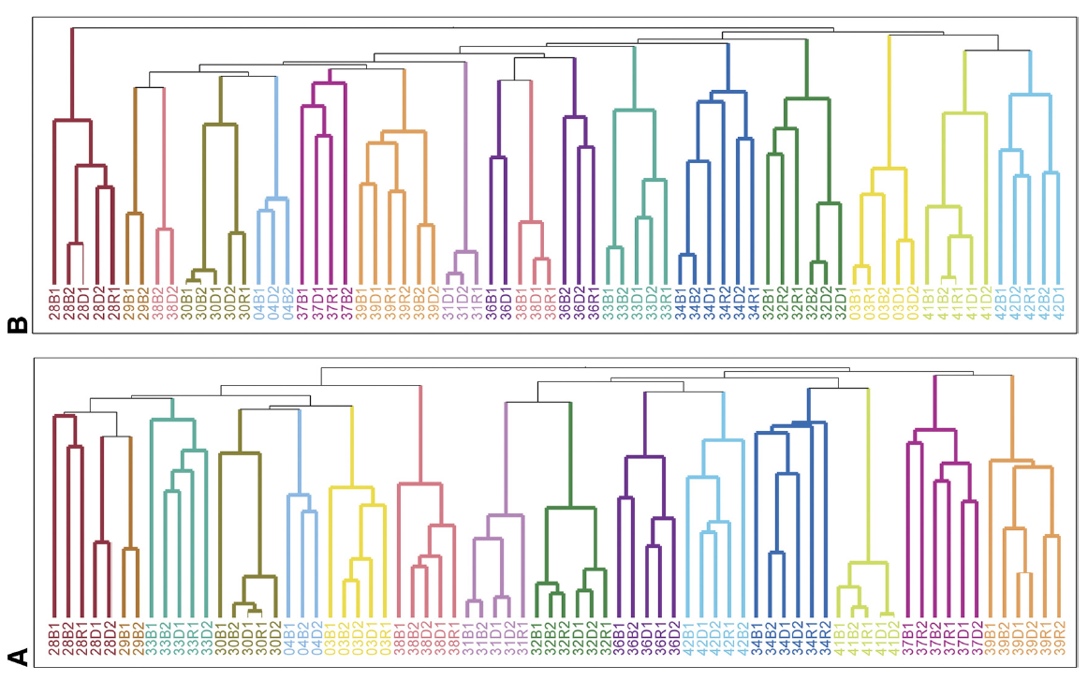
How easy it to change a microbiome?
The gut microbiome is individual, stable over time and surprisingly resistant to short-term changes in diet…
2011
Spencer et al, Association between composition of the human gastrointestinal microbiome and development of fatty liver with choline deficiency,2011

Slide 17
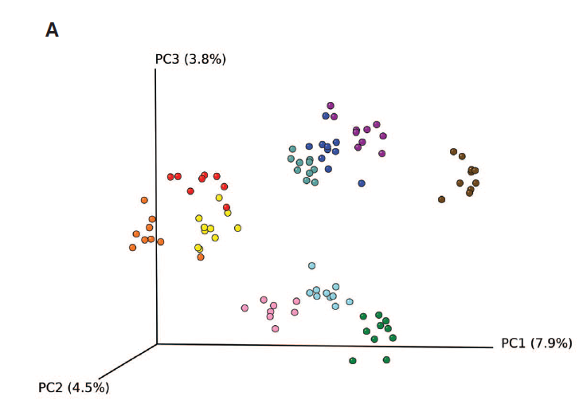
The gut microbiome is individual, stable over time and surprisingly resistant to short-term changes in diet…
2011
Wu et.al - Linking Long-Term Dietary Patterns with Gut Microbial Enterotypes, 2011

Slide 18
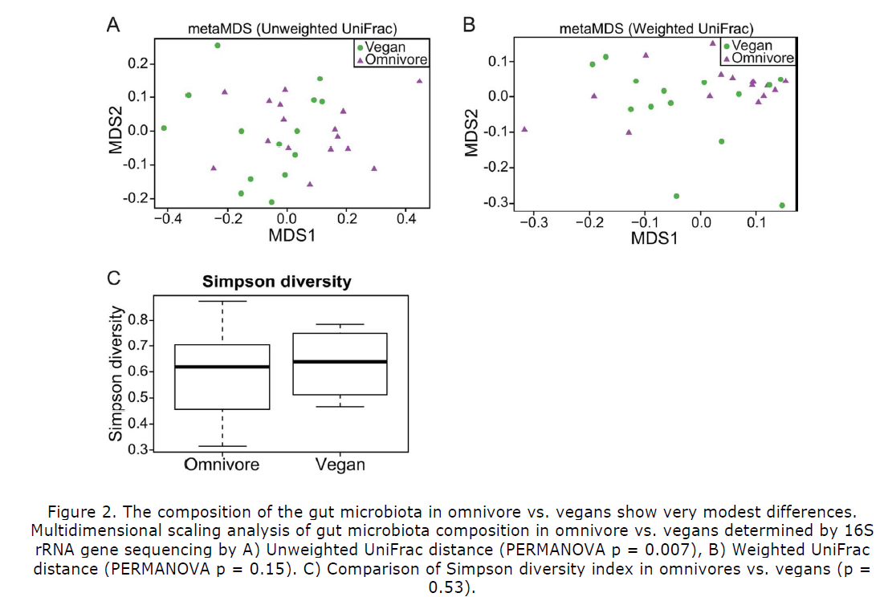
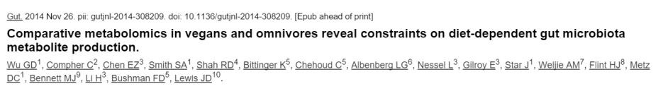
The microbiome of vegans is pretty similar to omnivores…
2014

Slide 19
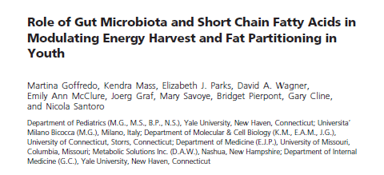
The microbiota is hard to change in adults
Can interventions be designed for earlier in life?
2016

Slide 20
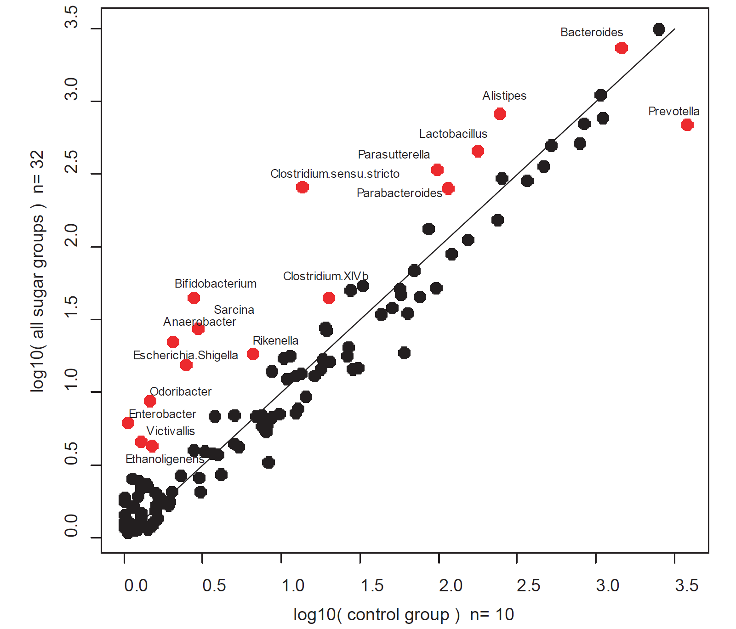
A rat model suggests the presence of sugar in the juvenile diet can have profound results on the microbiota
submitted
E.E. Noble, T.M. Hsu, R.B. Jones, A.A. Fodor, M.I. Goran and S.E. Kanoski. Early life sugar consumption affects the microbiome in rodents independent of obesity. (Submitted)

Slide 21
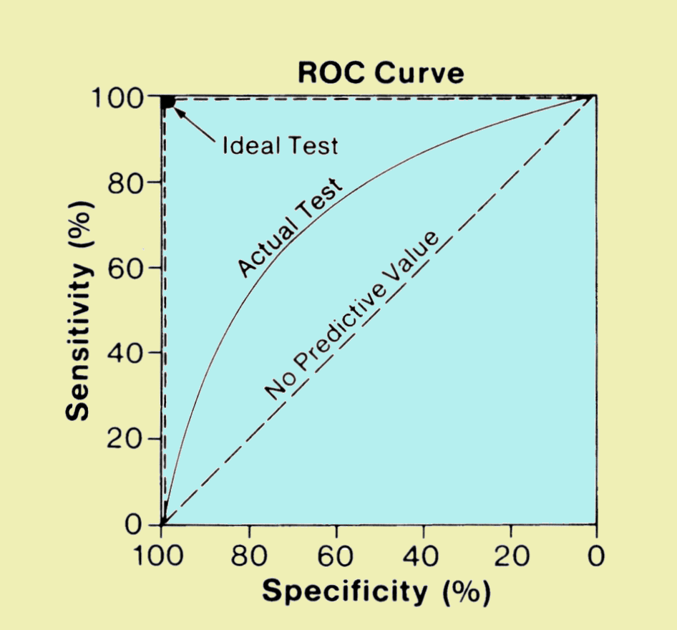
The “big data” approach to classification problems
Is a voter democratic or republican?
Voters with known affiliation
Training set
Test set
Find features
(income, zip code, gender)
that predict affiliation
Build statistical model
Make predictions on test set
Image: http://www.sprawls.org/ppmi2/IMGCHAR/1IMCHAR12.gif

Slide 22
The “big data” approach to classification problems
Is a sample case or control?
Whole-genome metagenome sequencing
on samples with known disease status
Training set
Test set
Find features
(taxa, genes)
that predict status
Build statistical model
Make predictions on test set
Image: http://www.sprawls.org/ppmi2/IMGCHAR/1IMCHAR12.gif

Slide 23
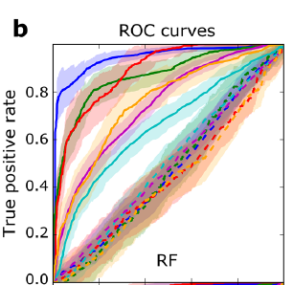
Whole-metagenome sequencing reveals effect sizes are much larger for other diseases
2016
Pasolli et al - Machine Learning Meta-analysis of Large Metagenomic Datasets: Tools and Biological Insights– mbio, 2016

Slide 24
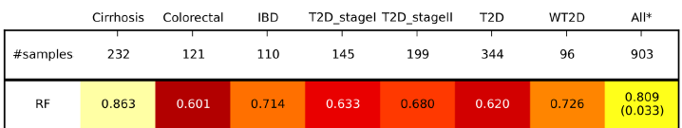
Remarkably, and perhaps disturbingly, replicability is maintained across disease states
accuracy
With regards to a microbial signature defined by whole-metagenome sequencing….
All disease states (across studies) have a good deal in common
All healthy states (across studies) have a good deal in common
2016
Pasolli et al - Machine Learning Meta-analysis of Large Metagenomic Datasets: Tools and Biological Insights– mbio, 2016

Slide 25
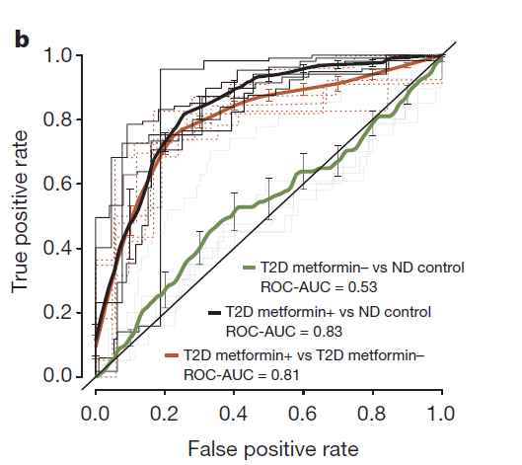
“Disease” state is heavily confounded with drug state
2015
Forslund et al Disentangling type 2 diabetes and metformin treatment signatures in the human gut microbiota– Nature, 2015

Slide 26
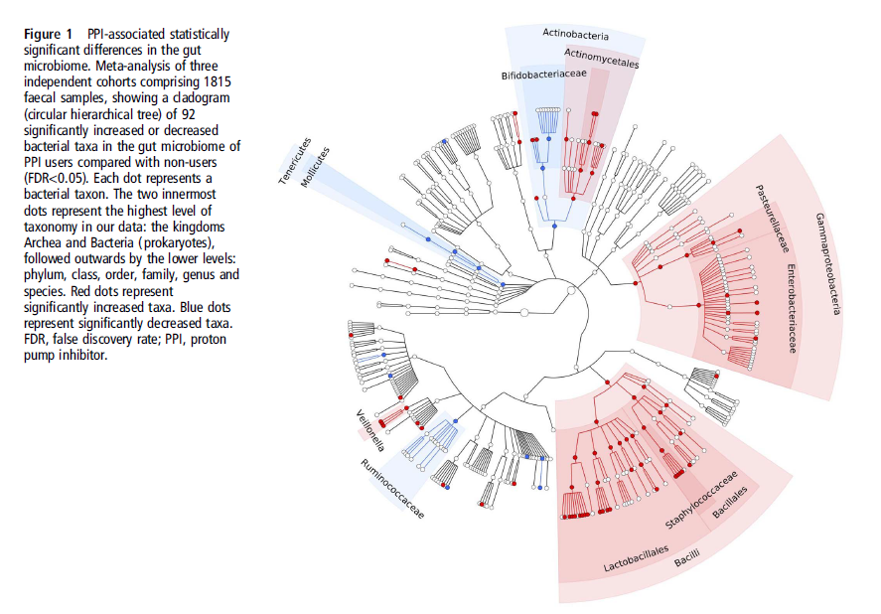
Proton pump inhibitors profoundly change the microbiome
2015
Imhann et al–Proton pump inhibitors affect the gut microbiome Gut, 2015

Slide 27
Obesity is causally linked to the microbiota via animal studies
but
Effect sizes in adult humans are very small
Human studies need thousands of participants and careful delineation of pharmacology
The adult microbiota is hard to change, which will complicate interventions.
More intervention studies are needed in youth.

Slide 28
An example of dysbiosis defined by one pathogen

Slide 29
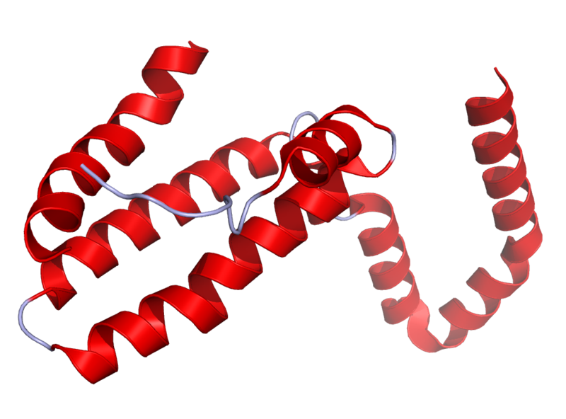
Il10^{-\-} Mouse Model
Il10 is an anti-inflammatory cytokine.
Inhibits pro inflammatory cytokines
Acts as an immunoregulator in the GI tract.
Lamblin, C., et al.,The Journal of allergy and clinical immunology, 2001.
http://en.wikipedia.org/wiki/Interleukin_10
Il10-\-
Il10^{-\-} mice are prone to inflammation with commensal tolerated by WT mice.
Knoch, B., et al.,Microbiology-Sgm, 2010
Established model for investigating disease phenotypes associated with inflammation

Slide 30
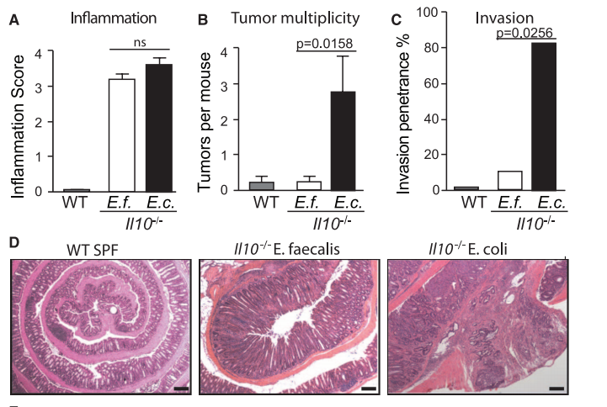
Some bugs, but not others, can cause inflammation to progress to cancer…
2012
Arthur et al, Science, 2012

Slide 31
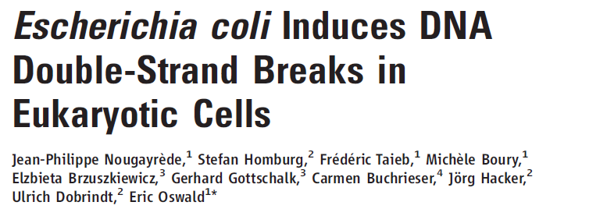
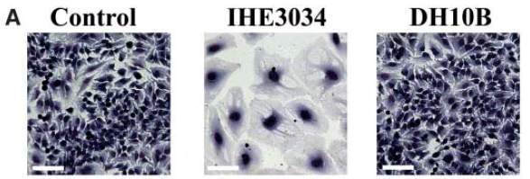
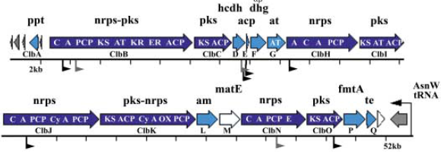
2006
Clinical E. coli isolates
change cell morphology
This activity is dependent
on the PKS island,
that encodes machinery
for polyketide and
non-ribosomal polypeptide
synthesis

Slide 32
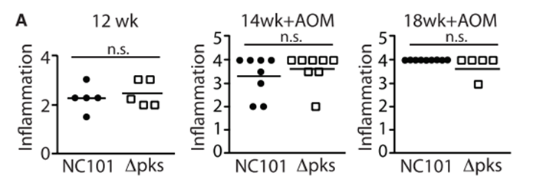
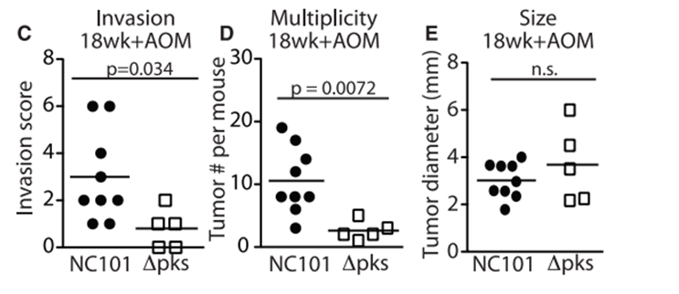
Remarkably, the PKS island appears essential in promoting progress to CRC
2006
2012

Slide 33
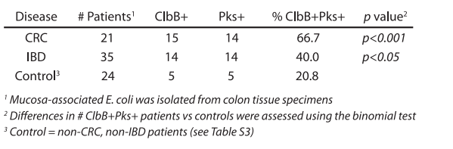
The presence of PKS is associated with cancers in multiple human cohorts
2006
2012

Slide 34
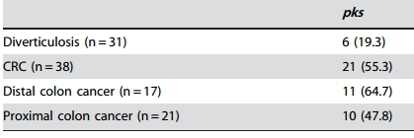
The presence of PKS is associated with cancers in multiple human cohorts
2006
2012
Buc et al - High Prevalence of Mucosa-Associated E. coli Producing
Cyclomodulin and Genotoxin in Colon Cancer (2013)
2013

Slide 35
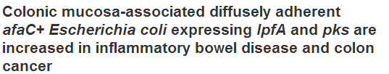
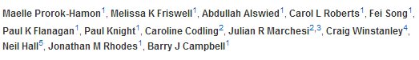
The presence of PKS is associated with cancers in multiple human cohorts
2006
2012
Buc et al - High Prevalence of Mucosa-Associated E. coli Producing
Cyclomodulin and Genotoxin in Colon Cancer (2013)
2013

Slide 36
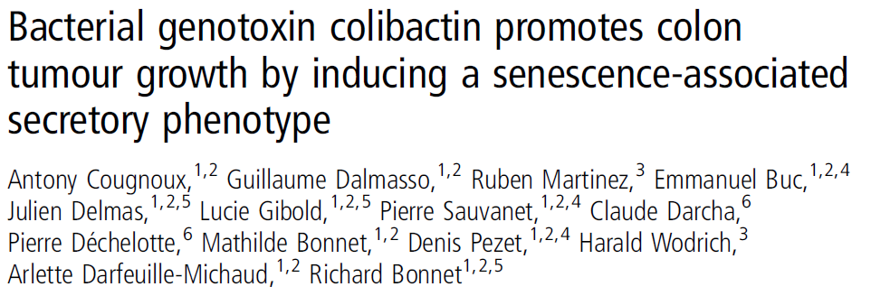
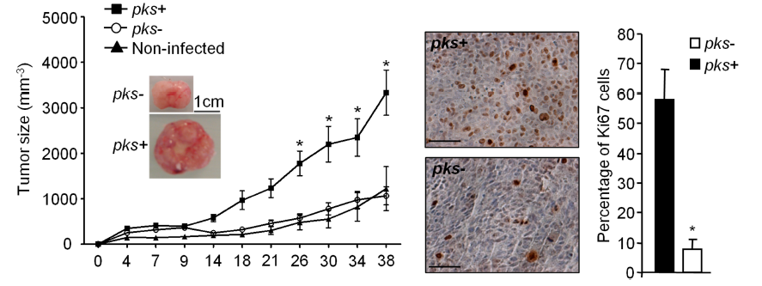
This oncogenic potential of PKS appears to be reproducible
in a HCT116 cell/ nude mouse system
2006
2012
2013
2014

Slide 37
How does the microbiome change over time in WT and inflamed animals?
6 WT cages
24 mice
5 Il10^{-\-} cages
17 mice
Illumina 16 V6 paired end sequencing of fecal samples.
Collected at 2, 12 and 20 weeks.
2x coverage by merging reads.
Clustered into OTUs
Bray-Curtis distances
PcOA (Mothur)
Mapped via blast to Silva database
Taxonomy assignment (RDP)
Arthur et al; Nature Communications; 2014

Slide 38
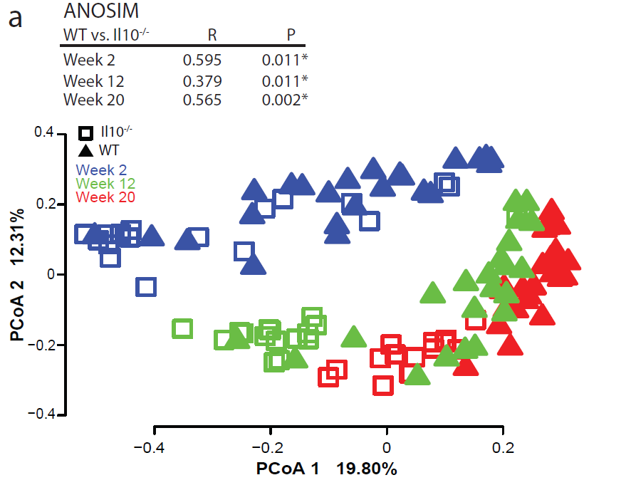
Time and inflammation are essential elements in structuring the microbial community
Arthur et al; Nature Communications; 2014

Slide 39
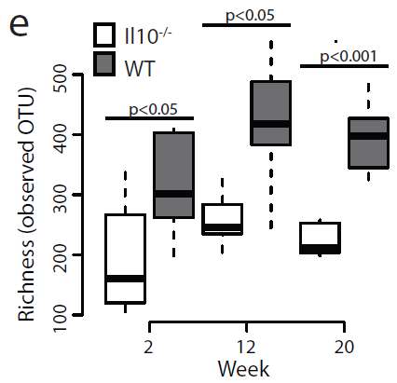
Inflammation interferes with normal succession…
Arthur et al; Nature Communications; 2014

Slide 40
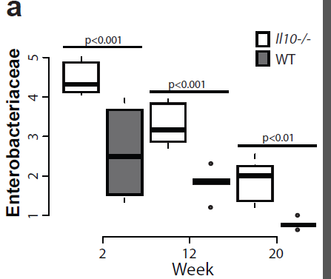
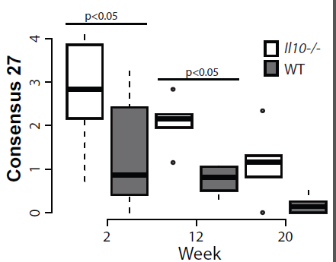
E. coli is selected against over time, but is always higher in inflamed animals
Arthur et al; Nature Communications; 2014

Slide 41
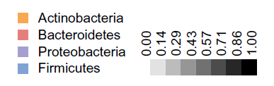
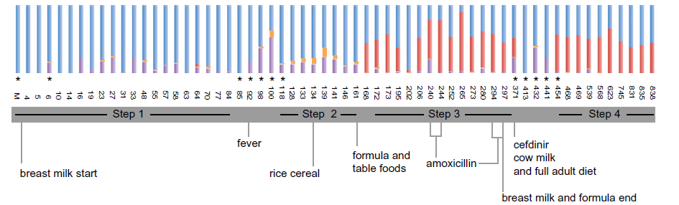
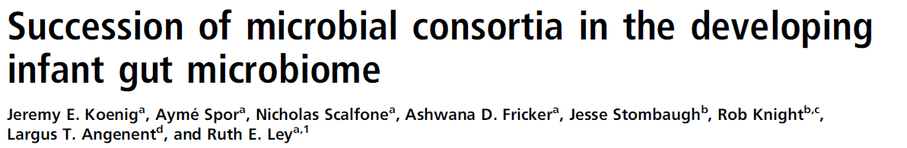
Proteobacteria selected against over time can be seen in human samples as well

Slide 42
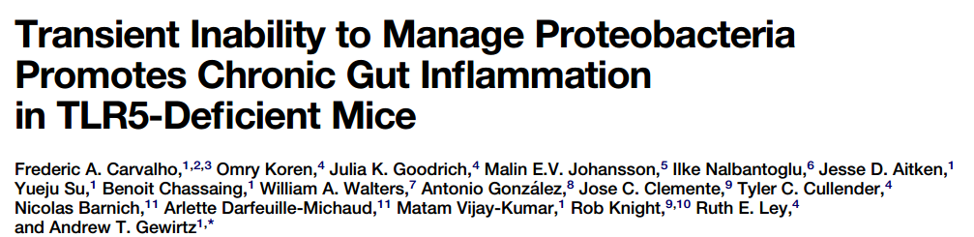
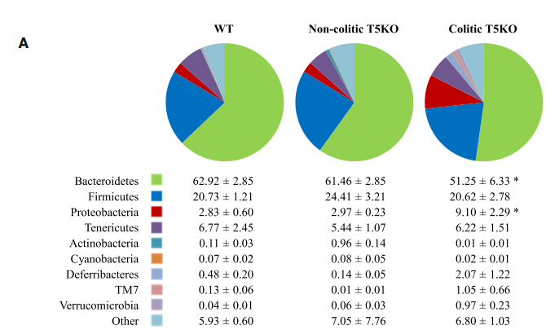
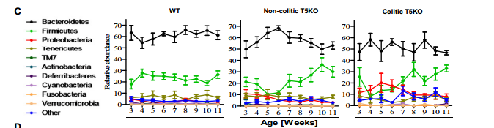
Inflammation interfering with normal succession is an emergent theme in the literature..

Slide 43
Does Westernization promote dysbiosis?

Slide 44


A related hypothesis to the dysbiosis hypothesis: the “lost microbiome” hypothesis.
Our modern Westernized microbiome is part of what contributes to disease.
We have lost beneficial bugs which we had evolved with and not have less helpful bugs…

Slide 45
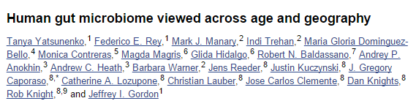
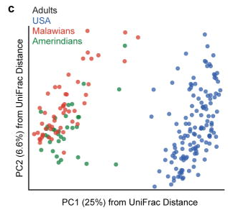
Certainly, non-Western microbiomes are very different from Western microbiomes
“healthy Amerindians from the Amazonas of Venezuela, residents of rural Malawian communities,
and inhabitants of USA metropolitan areas”

Slide 46
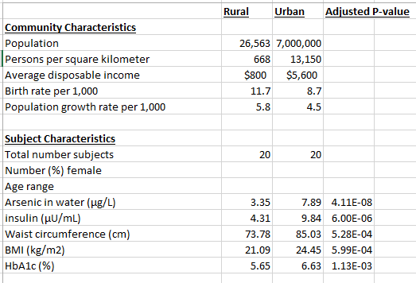
Neighboring regions in Hunan province have very different characteristics
Kathryn Winglee, Annie Green Howard, Penny Gordon-Larsen, manuscript in preparation

Slide 47
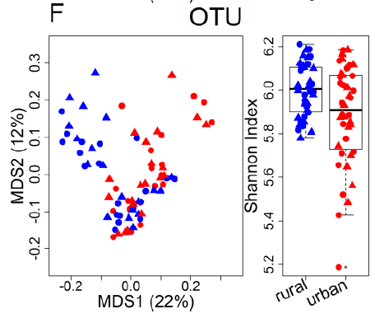
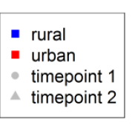
To the list of differences, we can add differences in the microbiotia
Kathryn Winglee, Annie Green Howard, Penny Gordon-Larsen, manuscript in preparation

Slide 48

Differences constrained to lower levels of the evolutionary tree provide evidence of niche selection

Slide 49

Bacteria in rural China are less like U.S. bacteria (and are not as well studied)

Slide 50

Among the bacteria that are higher in urban China is genus Escherichia

Slide 51

The metabolome is strongly correlated with urbanization
Ten of the 16 significantly different metabolites were involved in lipid, carbohydrate and energy metabolism – all key urban-rural diet differences
Winglee et al. Submitted

Slide 52


Whole-genome sequencing suggests there are areas of the tree of life
that are associated with urbanization that we will not capture with 16S rRNA sequencing
Archaea
Virus
log relative abundance
log relative abundance
rural urban
rural urban
P = 0.009
P = 0.02

Slide 53

Genes associated with antibiotic resistance are significantly associated with urbanization
Proportion of
reads mapped
to cards database
rural urban

Slide 54

Computer then and now…
What will microbiology look like when we
can carry around whole-genome microbiome
samplers in our hand?
Will there be an iPhone sequencing app?
If you can sequence them in real time,
microbes are no longer invisible…
We are only beginning to define dysbiosis
http://en.wikipedia.org/wiki/Moore's_law

Slide 55












Acknowledgements
UNC-Chapel Hill
Janelle Arthur
Annie Green Howard
Marcus Muhlbauer
Penny Gordon-Larsen
UNC-Charlotte
Roshonda Barner
Ra’ad Gharaibeh
Jon McCafferty
Kathryn Winglee
UF- Gainesville
Christian Jobin
USC
Tanya L Alderete
Michael Goran
Emily Noble
Scott Kanoski
Kathryn Winglee
Annie Green Howard
Penny Gordon-Larsen
Raad Gharaibeh
Jon McCafferty
Marcus Muhlbauer
Janelle Arthur
Christian Jobin

